Slide 1
Time Series Project
Analysis of Hong Kong Market Data
Jason Herbaugh and Alexander Sepenu

Slide 2
Questions of Interest
Do short term investment yield a high return?
Do long term investment follow the same investment pattern?
Does other indicators in the Hong Kong Housing Market data impact the Hang Seng Index?

Slide 3
Data Set Summary
Data: https://www.kaggle.com/stanley11291985/hk-macroeconomics-data
Economic data for the Hong Kong Private Housing Market
  Collected between 2003 and 2019
  Variables include:
    Hang Seng Index (total volume and close price)
    Index data for Consumer Price and Private Domestic Housing
    Unemployment Rate and Bank Interest Rate
    Inventory (built/sold/vacant)
    Sales Metrics (quantity/amount)
No Missing Data or Outliers
EDA Project: https://github.com/jherbaugh/MSDS6373_TS_Project

Slide 4
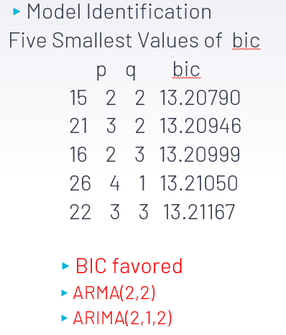
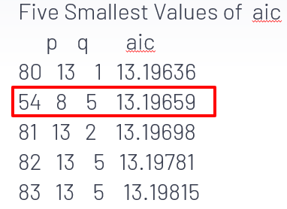
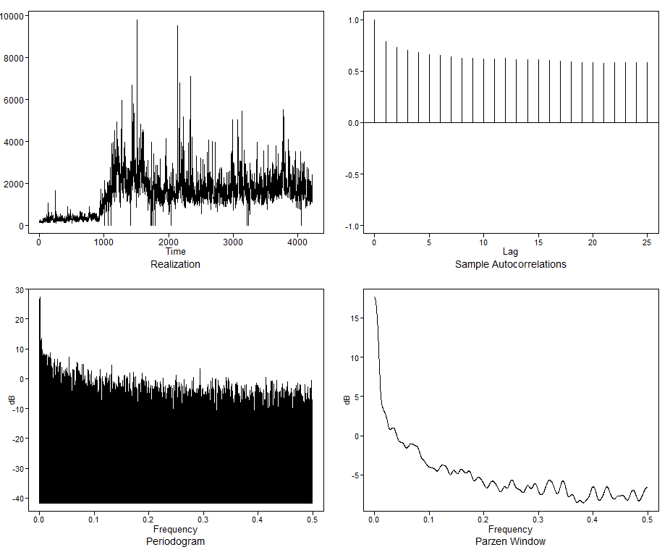
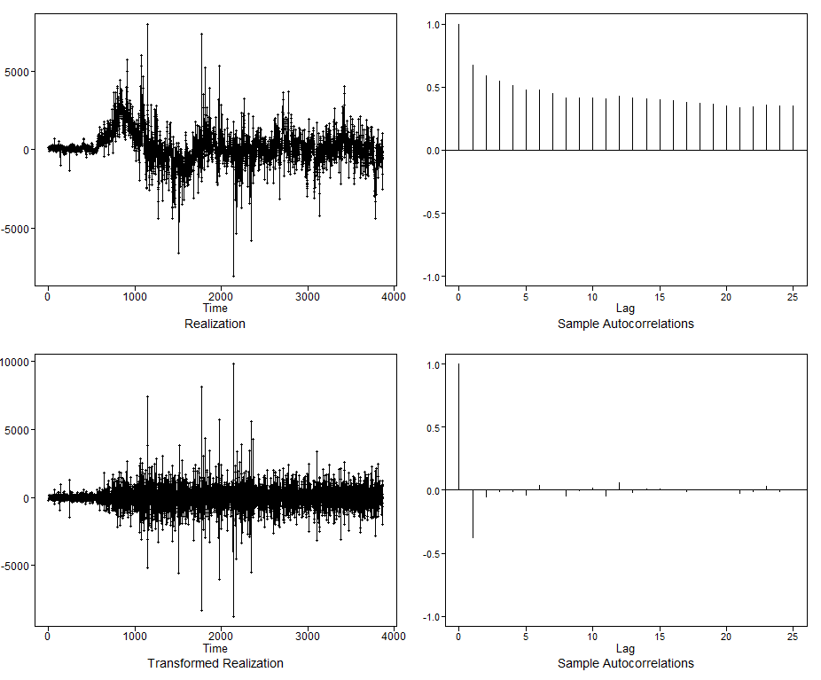
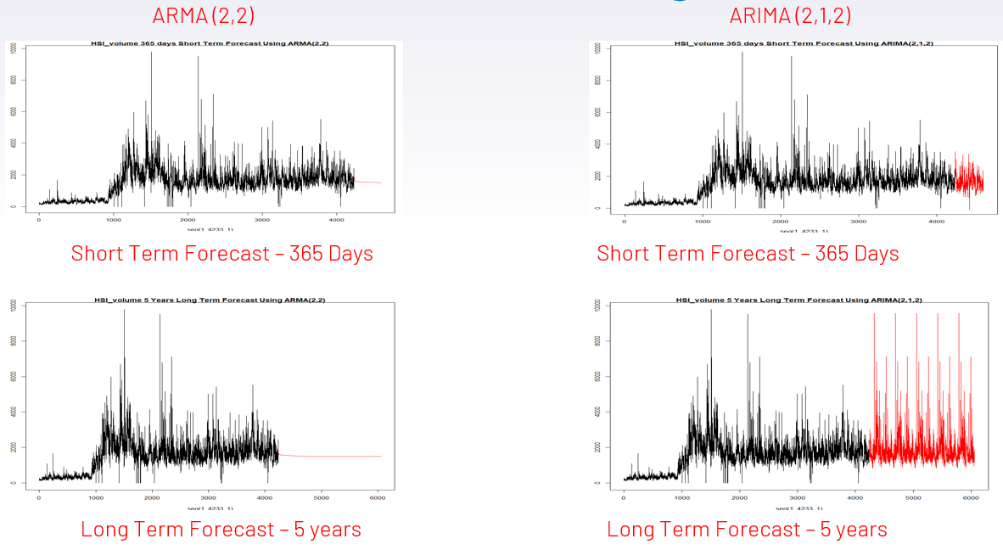
Univariate Analysis – Hang Seng Index (HSI) Volume
Before Differencing
After Differencing
Model Forecast

Slide 5
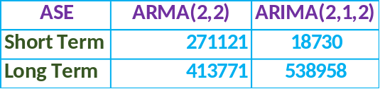
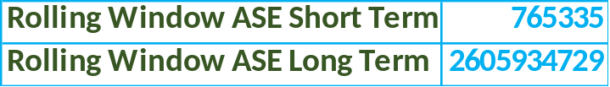
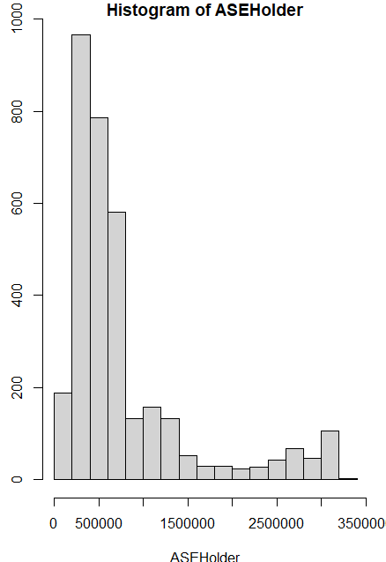
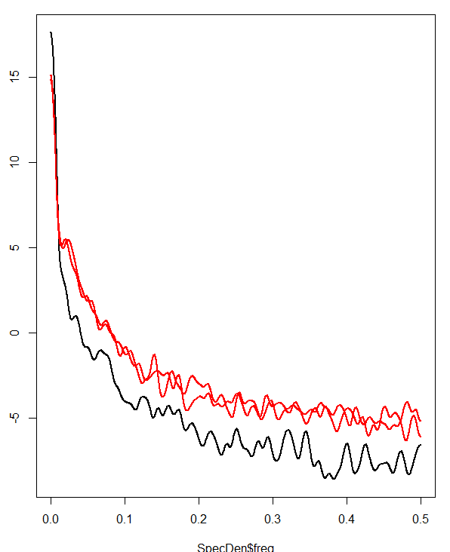
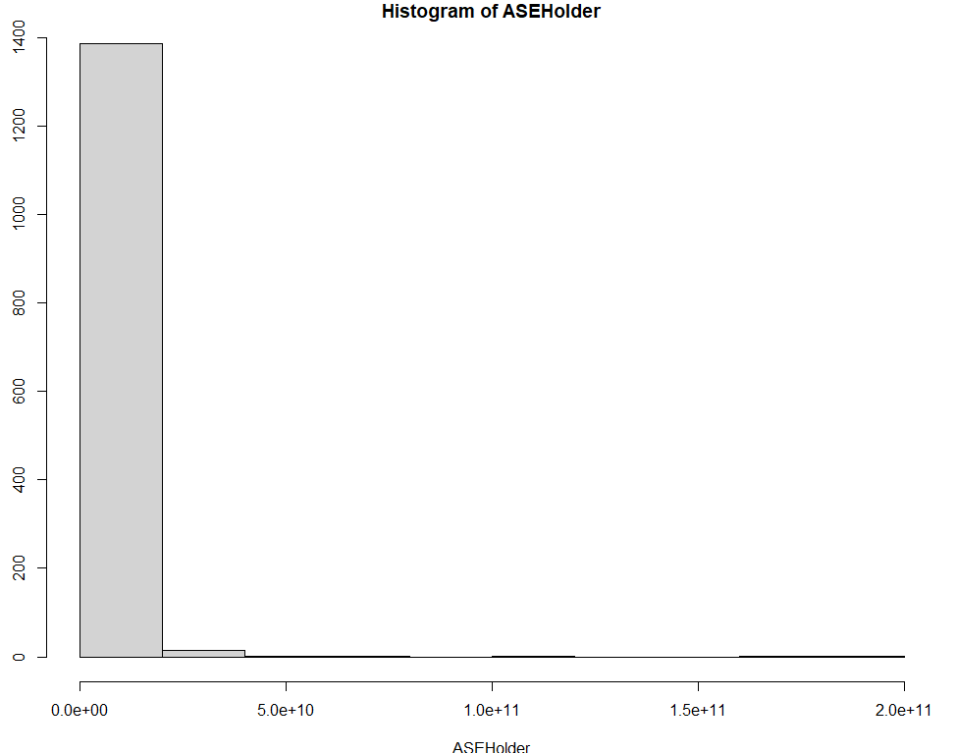
HSI Volume – Model Evaluation
Short Term Rolling ASE
ARMA(2,2) Model Spectral Density is Consistent with Actual Spectral Density for Series
Long Term Rolling ASE

Slide 6
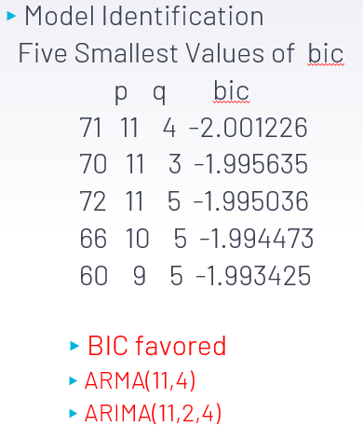
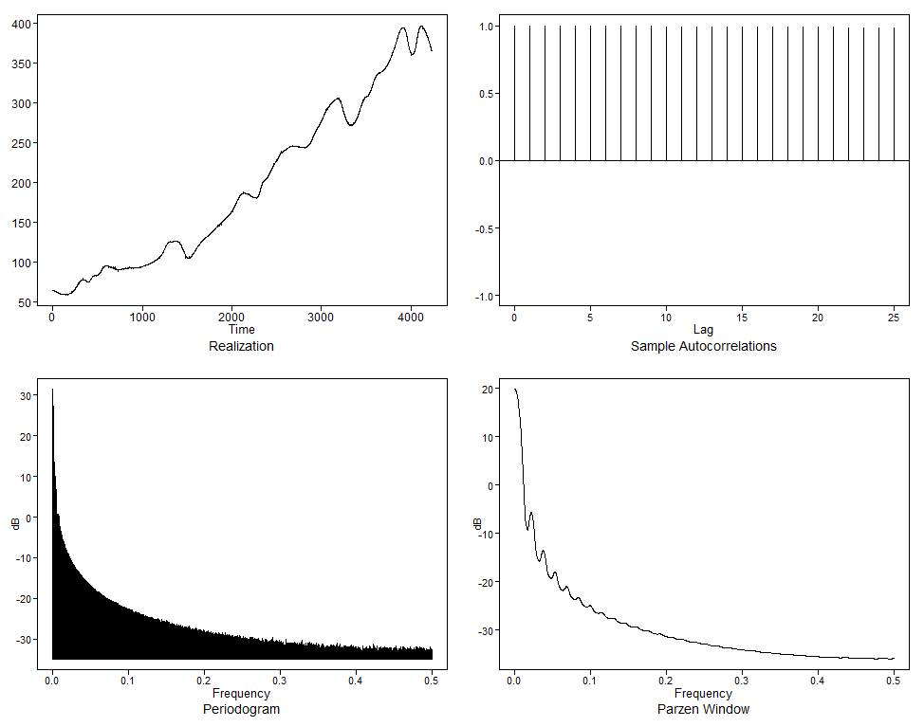
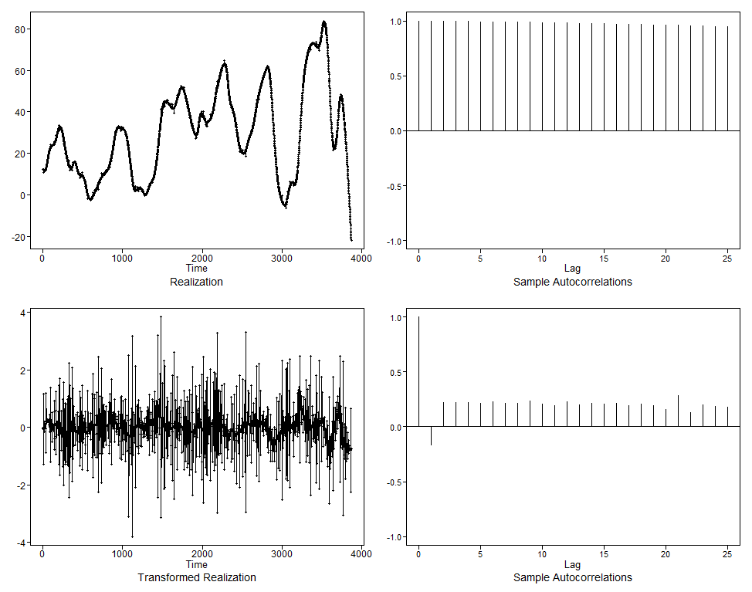
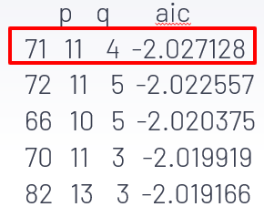
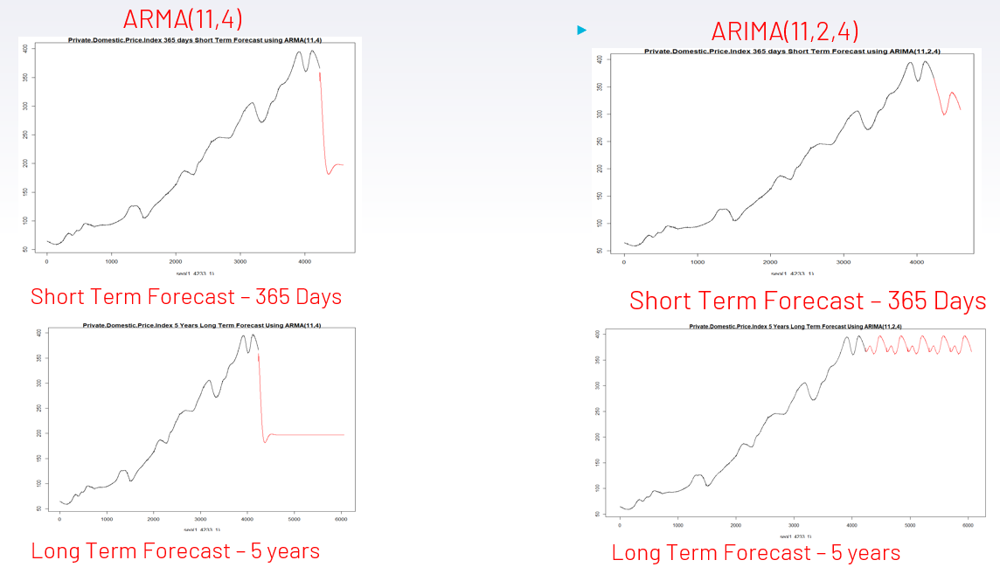
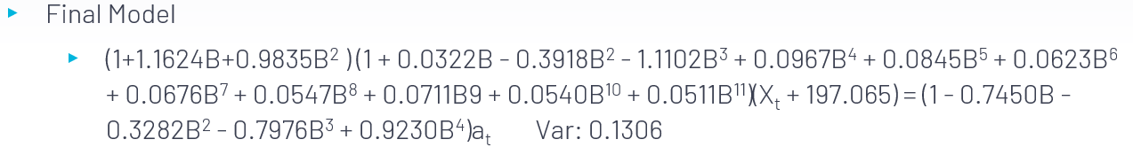
Univariate Analysis – Price Index
Before Differencing
After Differencing
Model Forecast

Slide 7
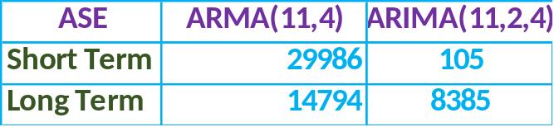
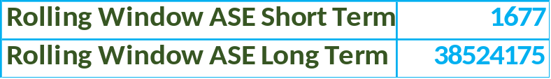
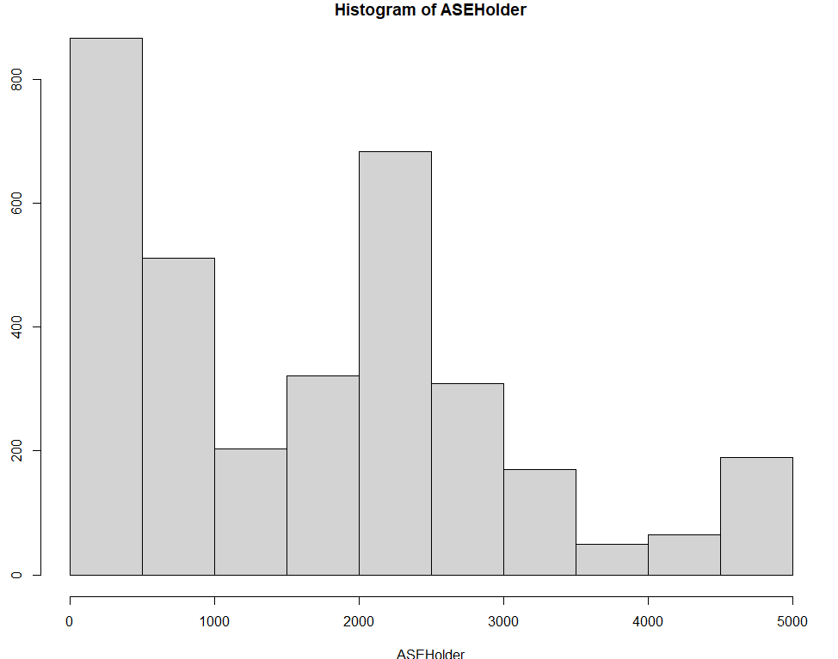
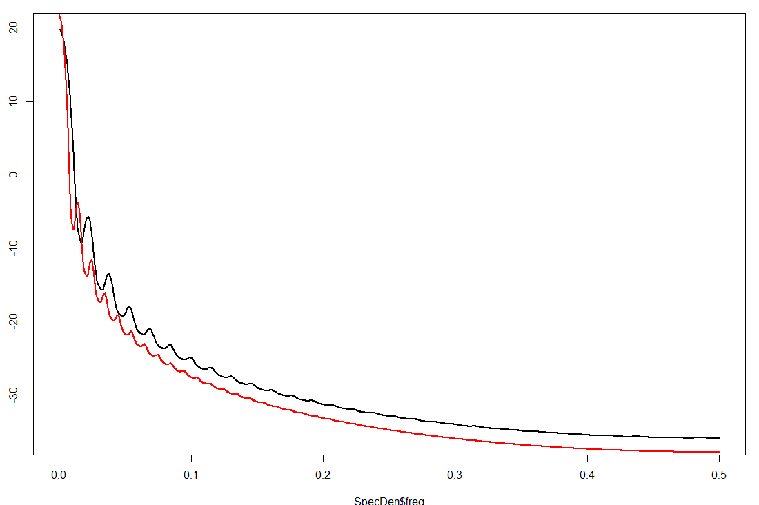
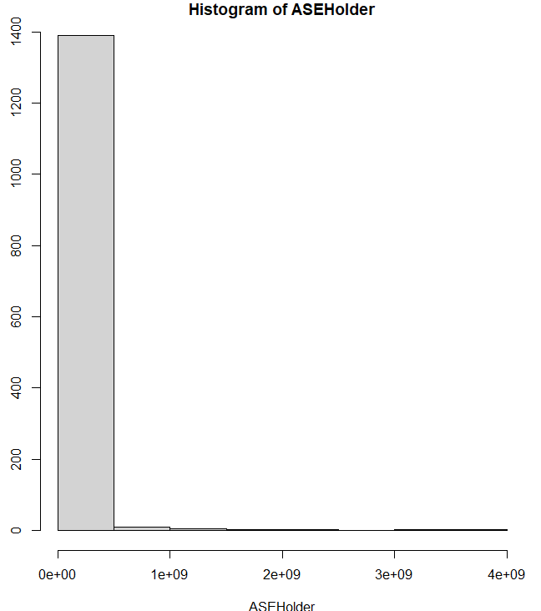
Price Index– Model Evaluation
Short Term
Rolling ASE
ARIMA (11,2,4) Model Spectral Density is Consistent with Actual Spectral Density for Series
Long Term
Rolling ASE

Slide 8
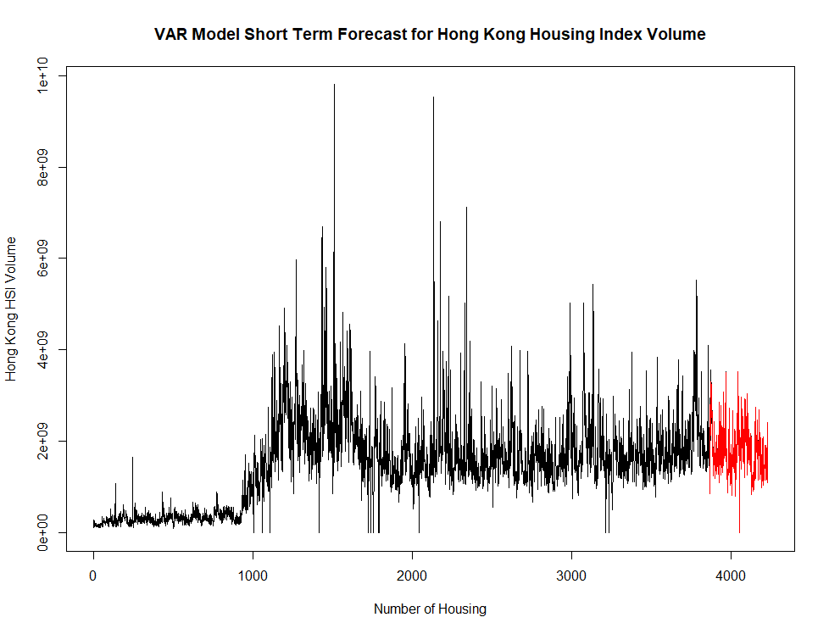
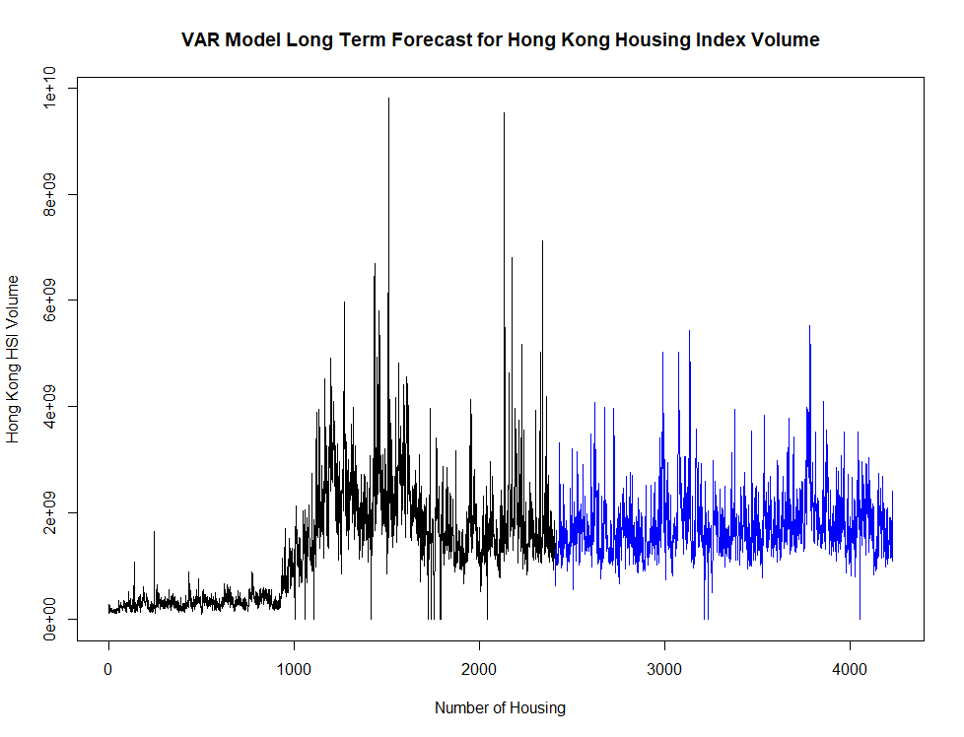
Var Analysis
Model Forecast – Short Term
Model Forecast – Long Term
 | ASE
 | Var Model
Short Term | 2156448 x 10^9
Long Term | 4314745 x 10^8

Slide 9
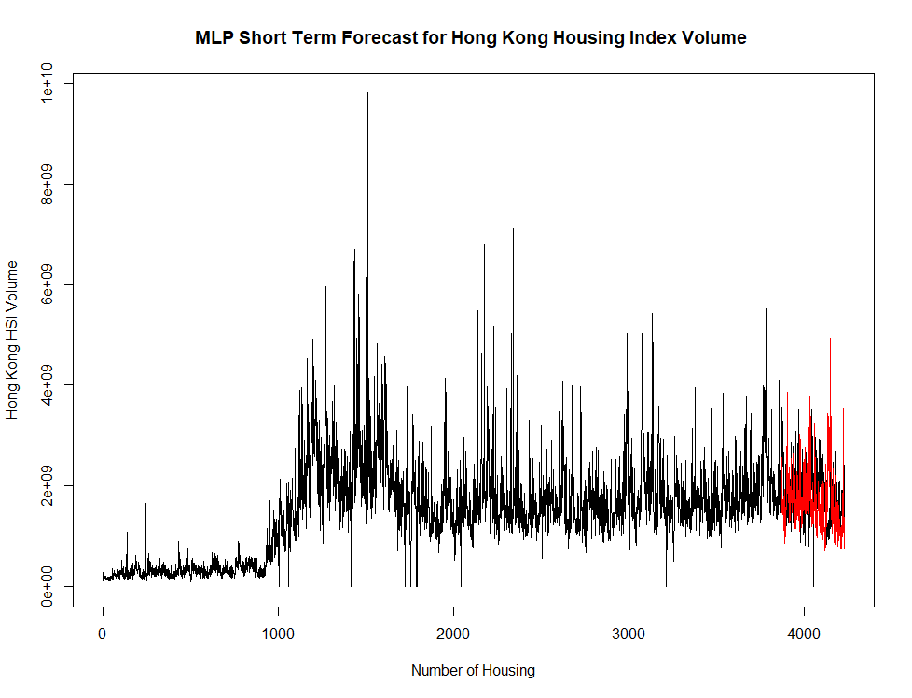
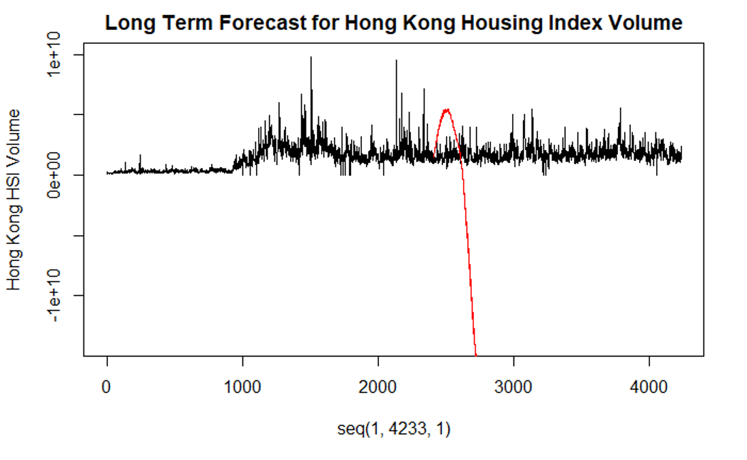
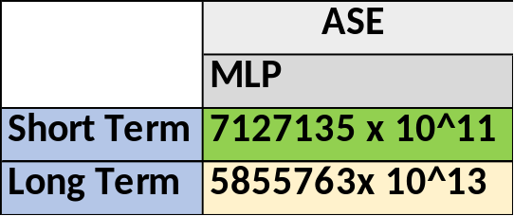
MLP Analysis
Model Forecast – Short Term
Model Forecast – Long Term

Slide 10
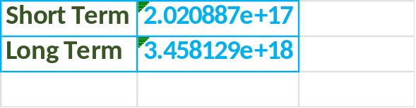
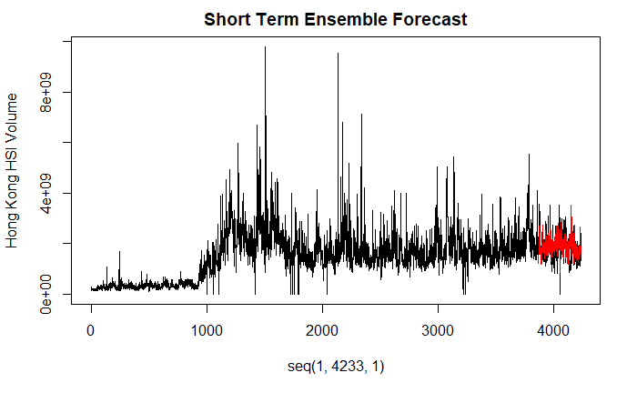
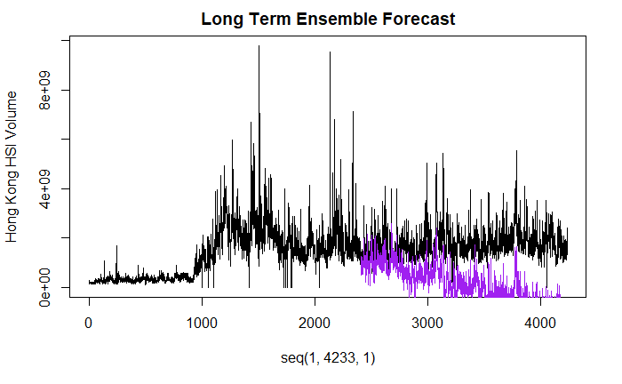
Ensemble Forecast Analysis
Short Term
Forecast
Long Term
Forecast

Slide 11
Findings
 | ASE
 | ARMA(2,2) | ARIMA(2,1,2) | Var Model | MLP | Ensemble
Short Term | 271121 | 18730 | 2156448 x 10^9 | 7127135 x 10^11 | 1792094 x 10^11
Long Term | 413771 | 538958 | 4314745 x 10^8 | 5855763x 10^13 | 1459824 x 10^13
Most of models used turn favor a short-term investments over long term investments based on their associated ASEs
Holding all other indicators constant, using the Hang Seng Index, with 95% confidence most return on investment will be realized in the short term should management invest in the Hong Kong Housing Market.

